Slide 1

Parent Welcome Meeting
2026-2027

Slide 2

School Staff
  Head of School- Miss Bullock
  Assistant Head of School- Mrs Sanders
  SENDco-Miss Swift
  School Administrators-Mrs Turner, Mrs Lake, Mrs Cox
  Nursery Leader-Mrs Rowe
  Reception Teachers- Mrs Grant, Mrs Kistle
  KS1 Teachers- Mrs Taylor, Miss Welch, Miss Debes
  KS2 Teachers- Miss Clark, Mrs Walters, Mr Walker, Miss Munson, Mr Hayne, Miss Vickery, Mrs Waite

Slide 3
School Staff
  Nursery support staff- Mrs Vercoe, Mrs Simmons, Mrs Annear
  Reception support staff- Mrs Thomas, Mrs Hart
  KS1 support staff-: Mrs Hemley, Miss Chellew, Mrs Bowes, Mrs Best
  KS2 support staff- Miss Collins, Mrs Green, Mrs Eaton, Miss Dowrick, Miss Moore, Mrs Garrett, Mrs Hooper, Miss Best, Mrs Pagram, Mrs Heard
  Sports coach- Mr Webb

Slide 4
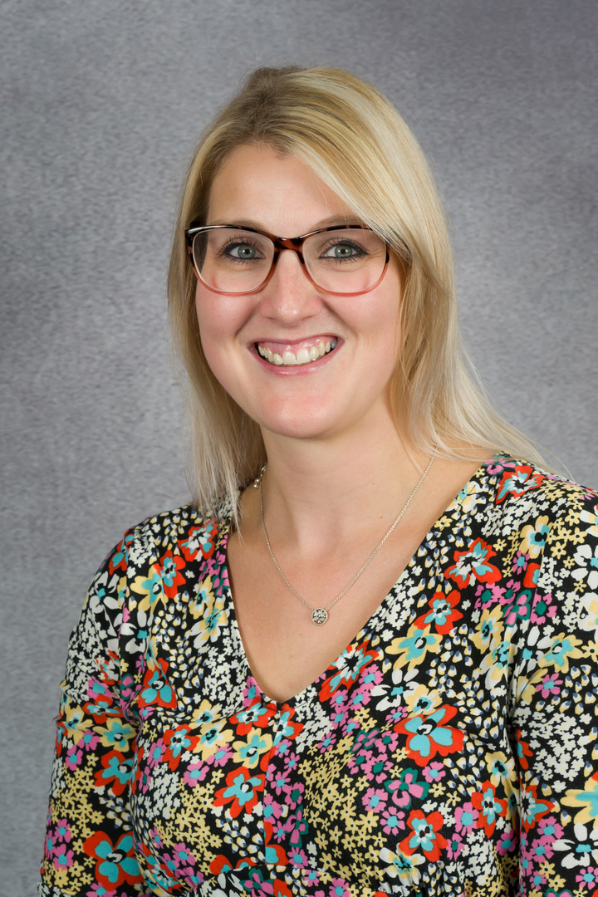
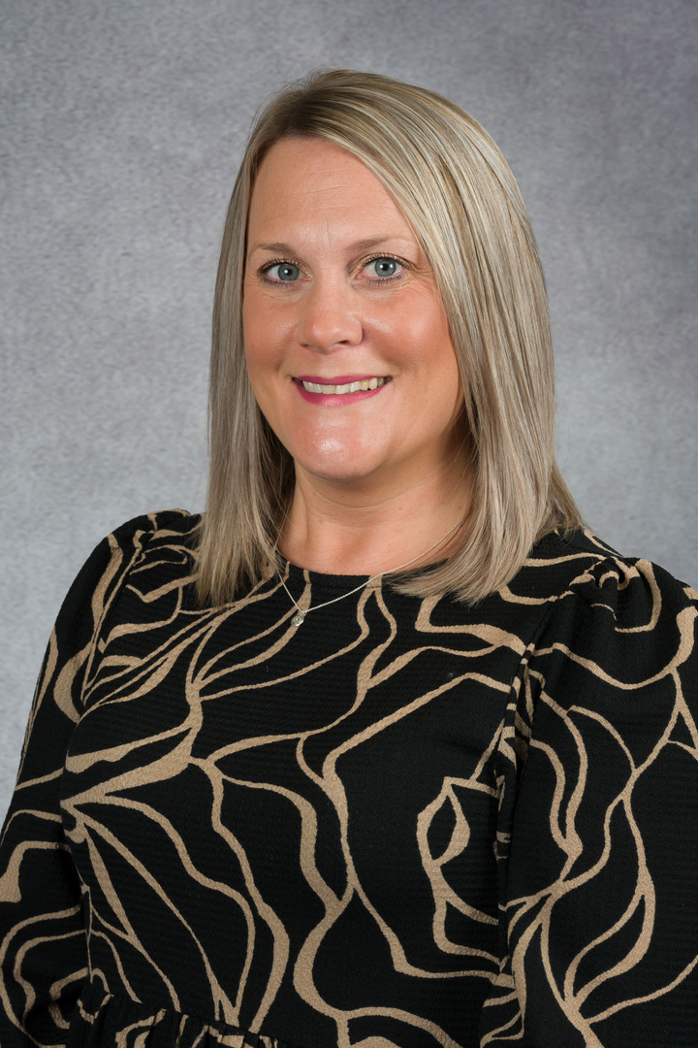
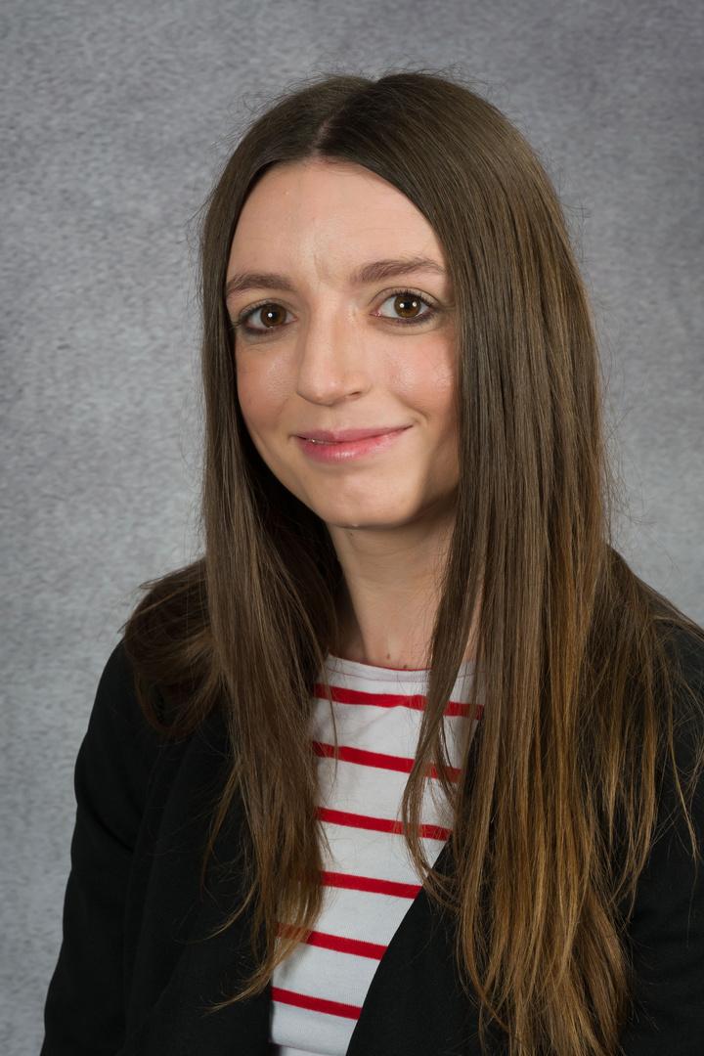
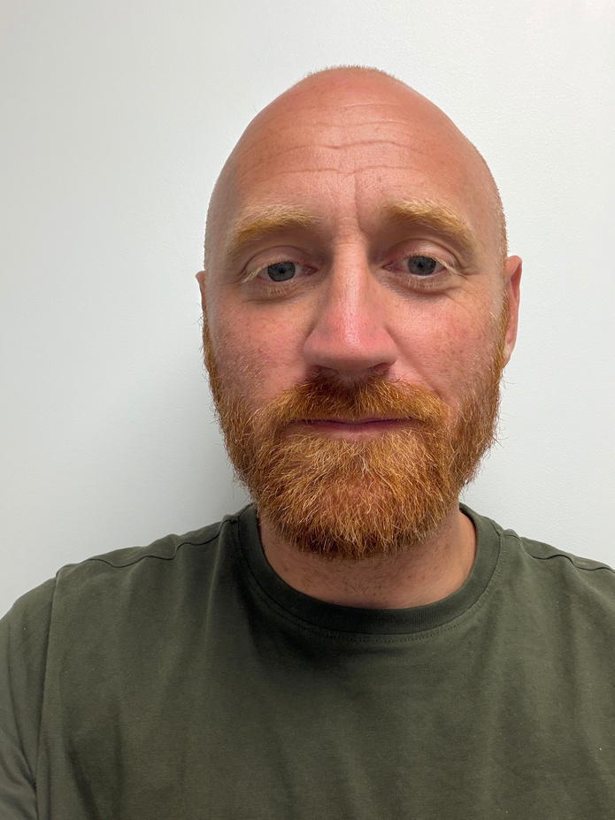

Safeguarding Team
Designated Safeguarding Lead
Mrs Sanders
Assistant Head of School
Designated Safeguarding Lead
Mrs Sanders
Deputy Designated Safeguarding Lead
Miss Bullock
Head of School
SENDco
Miss Swift
Level 3 Safeguarding
Mr Walker
Teacher
Aspire Director of Safeguarding
Mrs S Hannaford
Director

Slide 5
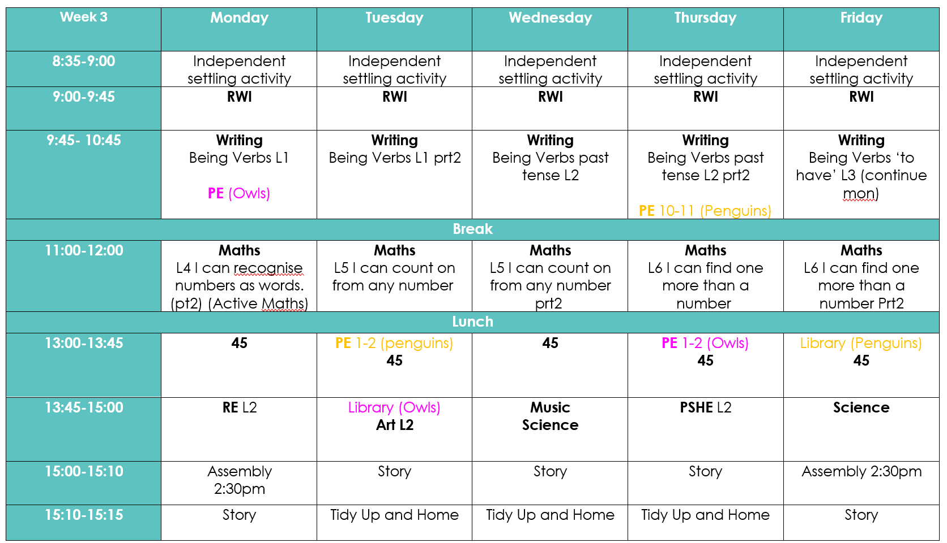
A Typical Day
  Penguins
  PE Tuesday and Thursday
  Owls
  PE Monday and Thursday

Slide 6
Class Information
•P.E Days will be…
  Penguins
  PE Tuesday and Thursday
  Owls
  PE Monday and Thursday
Children must have a PE kit that includes black shorts/ joggers, trainers and White PE t-shirt on P.E Days and hair must be tied back.
•Please do not bring in any toys into school, including fidget toys (unless agreed in your child provision with SENDCO).
•Suitable sensible black school shoes – no trainers or logos

Slide 7
Visions and Values
Our vision
For every child to flourish in a nurturing environment, demonstrate respect and kindness, whilst building resilience and ambition for their future.
Roots to grow, wings to fly
Nurture Respect Ambition

Slide 8
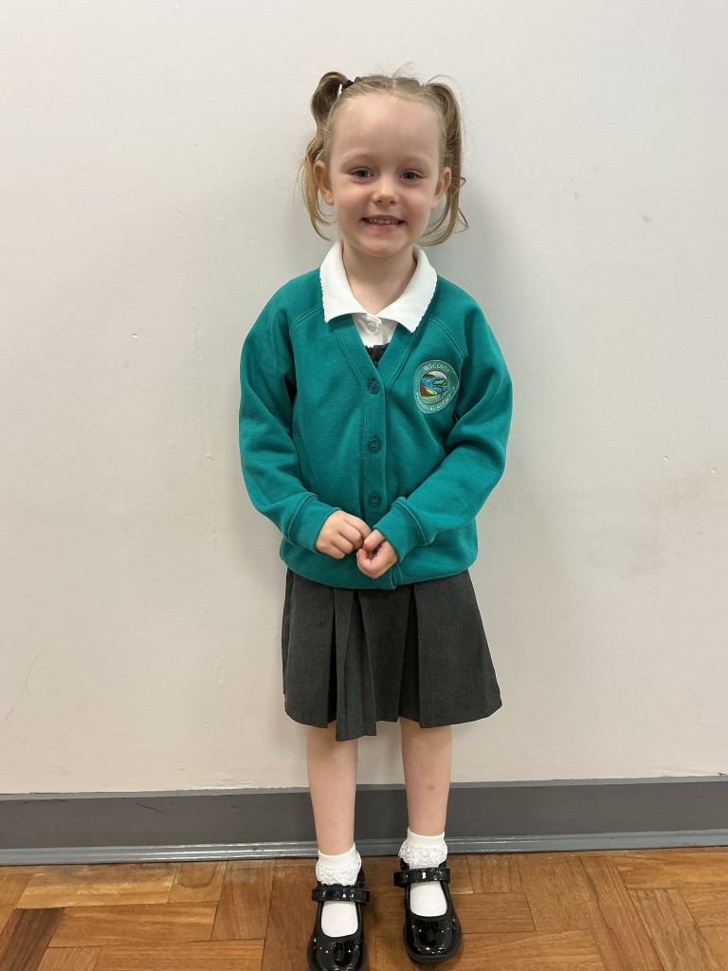
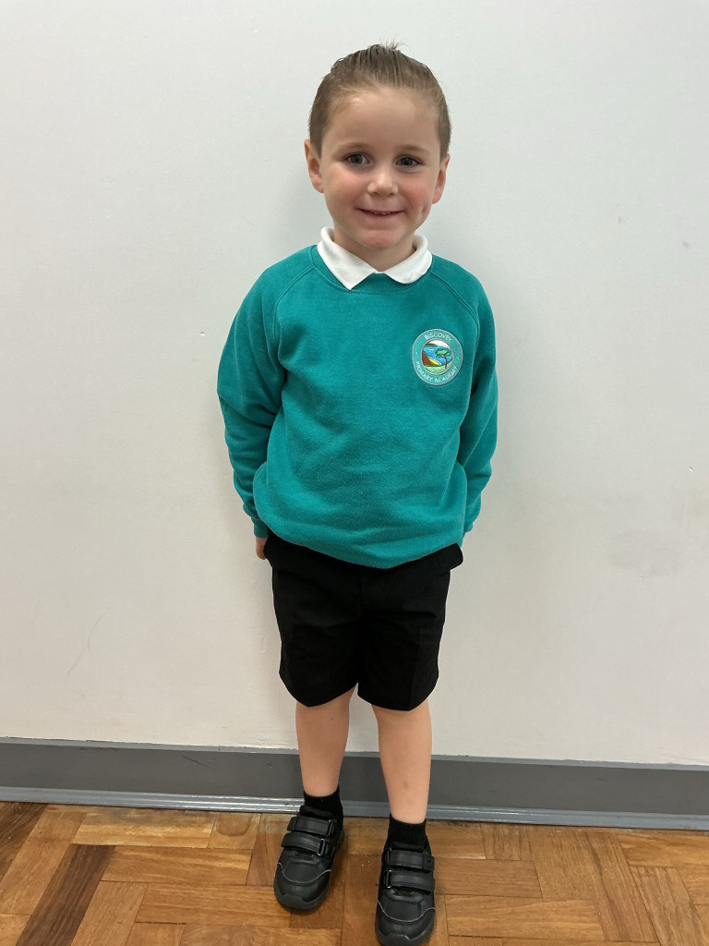
School Uniform
It is our expectation that all children come to school wearing the correct uniform including black school shoes.
Expectations for uniform can be found on our website.
Jewellery
The wearing of jewellery is not suitable for school and should not be worn. Where children have had their ears pierced, please use only stud ear-rings to avoid injury in P.E. or at playtime. (Cornwall Council Ruling)
Hair
From time to time all schools seem to have the recurring problem of head-lice. Children with long hair must have it suitably drawn back. Long flowing hair falling over eyes is not good for children’s sight and it is not conducive to neat work. Please ensure hair is neat and clean, some new hair-cuts may be fashionable, but can sometimes cause unnecessary ridicule in the playground. Tram-lines, Mohawks, dyed hair and braids are not considered suitable by our school.
Make up
Due to the age of the children in our school we feel it is inappropriate for them to wear make up and nail varnish.

Slide 9
Tapestry
Tapestry is an easy to use, secure online learning journal. This helps families and schools celebartate the child’s learning journey.
Teachers will be looking at what your child is doing and will create observations using words, documents, pictures and/or video clips which record these learning moments. These may also be flagged against areas of learning, and aspects, from a range of guidance materials that they could be using to support your child's development. You are also able to add things that your child does at home using observations of your own, such as talking about what they see on a walk or completing a model over a period of time. With Tapestry, you can easily add your own observations using the app or the browser.
Teachers will add home learning onto Tapestry each week, these are fun simple activities linked to your child’s current learning. Please add these onto Tapestry so we can celebrate their home learning in class with the children.

Slide 10

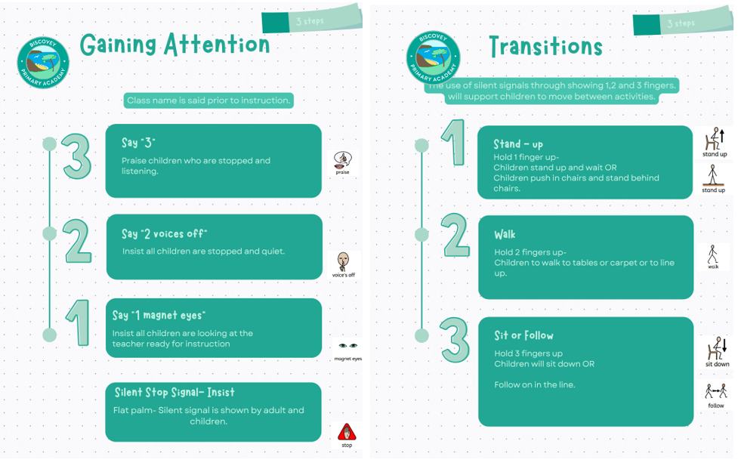

Behaviour and Achievements

Slide 11
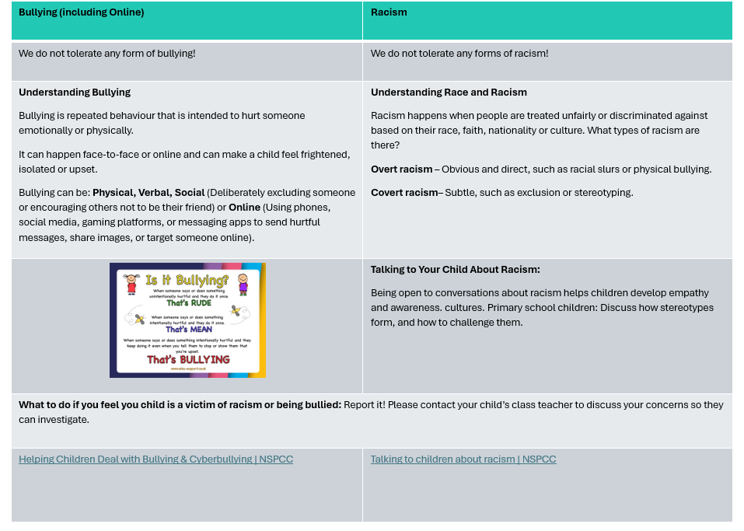

Slide 12
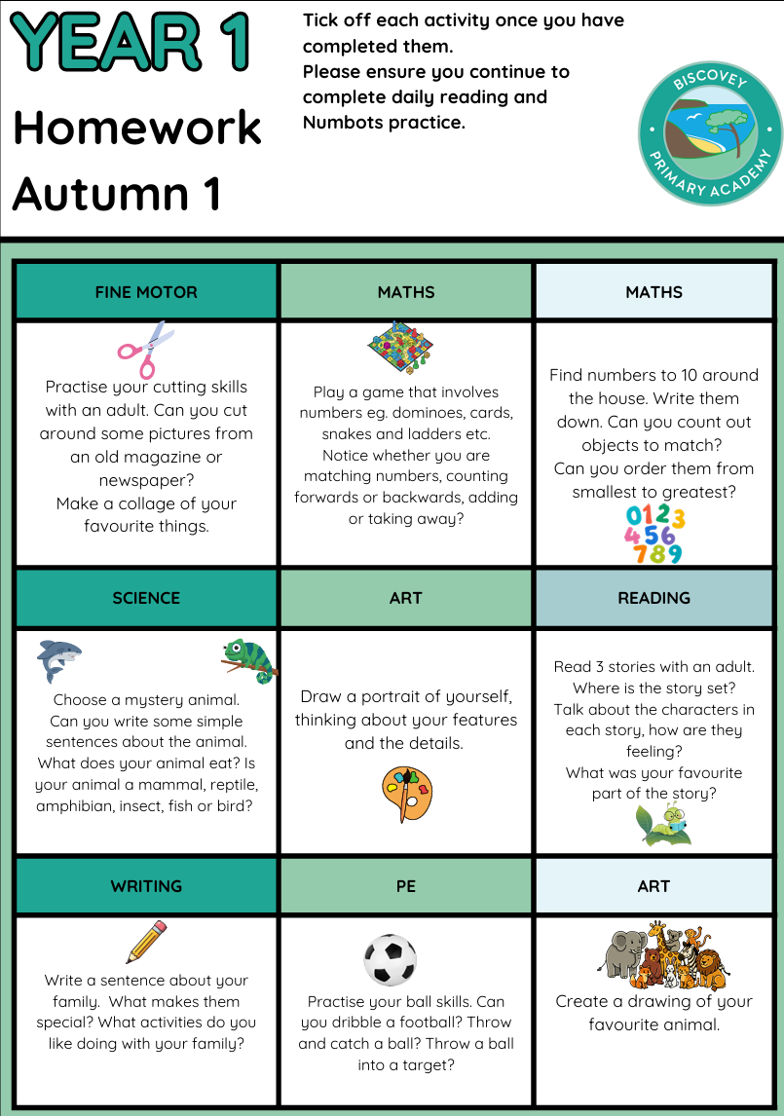
Home Learning
KS1 have individual homework books that need to be given in on a Wednesday morning.
1 activity is to be completed each week.
They will be returned to the children on a Friday.

Slide 13
Reading at home
Infants
Children will have reading books and reading records sent home. In Reception they will have speed sounds sent home daily.
To support your child with their reading we ask that you read at home daily and record in their records.
Reading rockets are used to celebrate reading at the infants.
Star books and spot books are sent home at Infants and a Library book.
Special awards for each 100 reads from Miss Bullock ​

Slide 14
Numbots
At the infants children have access to Numbots at home to strengthen and practice their number fact skills. Login details are inside reading records.
Practice at home should be daily (a few minutes).

Slide 15
Assessment
Year 1 phonics screening
The Year 1 Phonics Screening Check is a national assessment taken by all year 1 pupils.
During the check, children will read a mixture of real and made-up words with a familiar adult in school.
The check takes place nationally each year in June during Year 1. Following our phonics workshop, phonics packs will be sent home to support families in practising and reinforcing phonics skills through regular reading and fun activities.
We encourage all children to read regularly at home, as this plays an important role in building confidence, fluency and success in both the Phonics Screening Check and their wider reading journey.

Slide 16
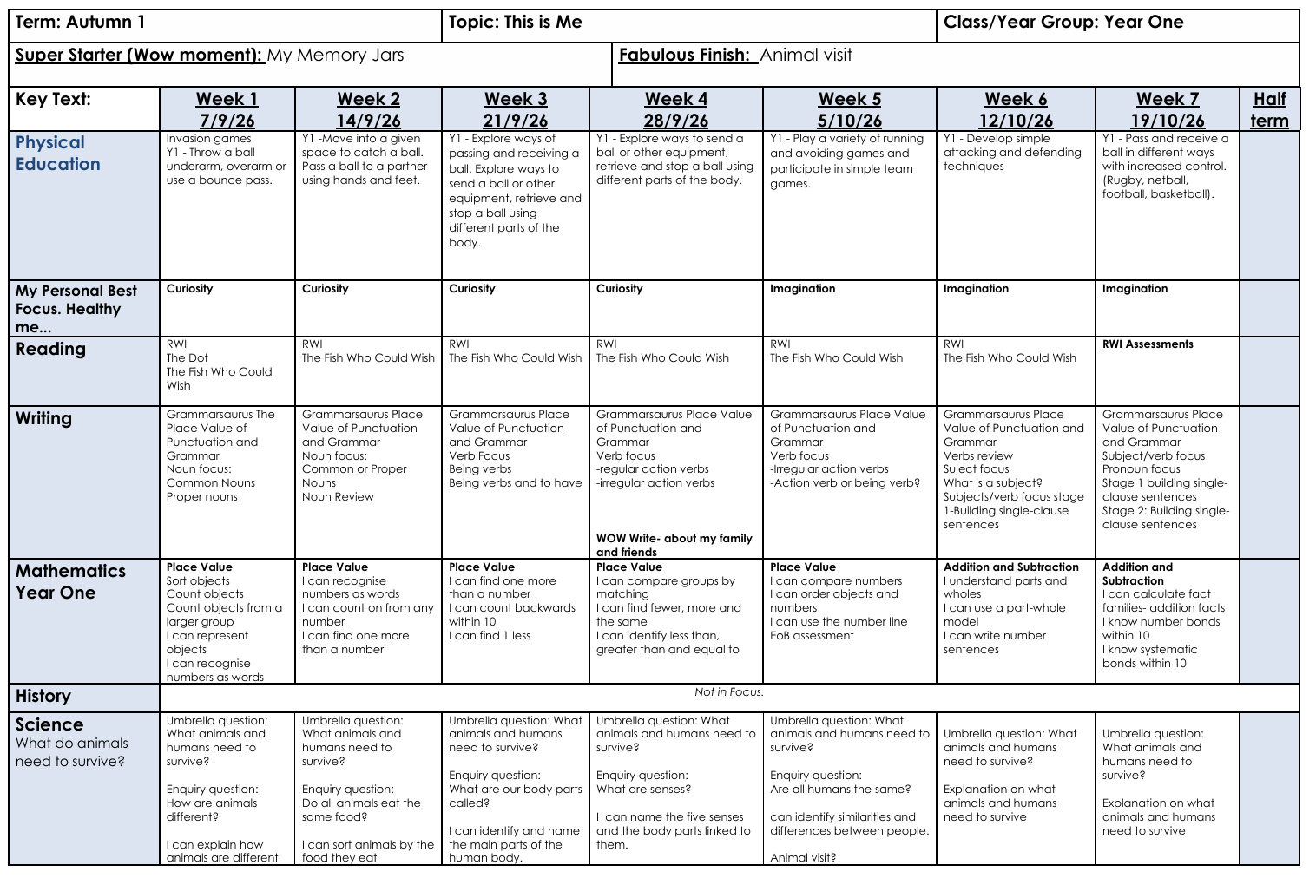
Curriculum

Slide 17

Medical Information
  We can only administer prescribed medicines.​
  You need to complete a form with relevant details from the office.​
  Forms need to be filled out for asthma inhalersand given to the office. Please ensure that theyare completed and given to school office.​
  Parent pay and Arbor logins have been sent, please ensure that you can login to these apps.
  All children with allergies or medical conditions will need to complete an Individual Healthcare plan with the class teacher.
  We are a nut free school
  Please ensure there are no products containing nuts within packed lunches (including Nutella) or for snack.
  Please provide fruit or a healthy snack for breaktime ​in KS2, KS1 are provided with fruit and do not need a snack

Slide 18
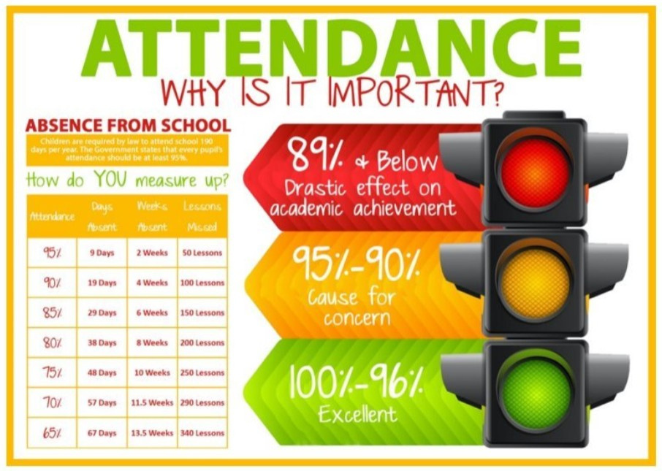
Attendance
Lateness can impact on attendance and how well children settle into their school day. It is important that children arrive on time.
Infants
Morning gate 8.35-8.45am
Register 8.45am
End of the day 3.15pm
Juniors
Morning gate 8.40-8.50
Register 8.50am
End of the day 3.20pm

Slide 19
Online Safety
Online Safety will be taught to children through computing lessons and our PSHE curriculum.
We value the importance of keeping children safe online. Please ensure that your child has parental controls on any devices at home.
There is more information about online safety and parent guides on the trust website:
https://www.aspireacademytrust.org/1094/online-safety
The trust also have newsletters for online safety that are shared with parents by email.

Slide 20
Communication
How to contact us:
  In all instances, please contact your class teacher first. You can also email via the school email address titled FAO: class teacher name OR catch them on the door.
  PLEASE NOTE: we do not use Tapestry as a platform for communication between the class teacher and parent. DO NOT message the teacher via Tapestry.
How we will contact you:
  We will share information via school website, emails and Arbor In app messages – this is a one-way information sharing platform.
  If we need to communicate with you individually, we will call you or send you an email via Arbor.
  Apps you will need:
  Arbor and ParentPay. Please note we no longer use Parent Pay.
  Parent Code of Conduct:
  We are all human, and we all have busy lives, challenges, and emotions. We kindly ask that all members of our school community treat teachers and staff with the same respect, patience, and kindness that they would wish to receive themselves
  Aspire-Code-of-Conduct-for-parents-May-23-1.pdf
  We will be sharing a ‘Who do I ask for in school?’ overview to parents so that you know who to contact.

Slide 21

School Website
Please visit the school website to find out more information about what your child is learning.
https://www.biscoveyinfants.org.uk

Slide 22
Support for Families
  As a school we are here to provide support and advice for families. ​
  If you are ever struggling or need support, please let us know as there are things we can do to help:​
​
  Listen and give advice​
  Provide second-hand uniform​
  Complete Foodbank voucher referrals​
  Signpost you to agencies for parent support​
  Early help hub referrals to the following services:​
  Mental health services Early years support​
  Health visitors/ school nurses Family and parenting support​

Slide 23

Support for Families

Slide 24
Thank You

